Slide 1
آشنايی با منابع نوين
اطلاعات بالينی و نقش آن‌ها در تصميم‌سازی اثربخش درمانی
دکتر پيام کبيری
پزشک، اپيدميولوژيست بالينی
رئيس مرکز توسعه و هماهنگی اطلاعات و انتشارات علمی
معاونت تحقيقات و فن‌آوری
وزارت بهداشت، درمان و آموزش پزشکی

Slide 2
Clinical Questions
There are 2 Types of Clinical Questions:
Background Questions
Foreground Questions

Slide 3
Clinical Questions
Background Questions
  Ask for general knowledge about a disorder.
  Two essential components: A question root (who, what, where, when, how) a disorder, or an aspect of a disorder
Foreground Questions
  These questions ask for specific knowledge about diagnosis, prognosis, and treating.
  The Patient and/or Problem, Intervention, Comparison & Outcome are included.

Slide 4

Foreground Questions
Background Questions
Experience with Condition

Slide 5
Information Resources
دانش پايه (Basic Knowledge)
کتاب‌ها (Books)
دانش روزآمد (Updated Knowledge)
مجلات و نشريات ادواری (Periodicals)

Slide 6
انواع مقالات در علوم پزشکی
Original Article
Review Article
Case Reports
Editorial
Short Communication (short papers)
Letter to Editor
مقاله پژوهشی اصيل
مقاله مروری
مقاله گزارش مورد
سرمقاله (سخن سردبير)
مقاله کوتاه
نامه به سردبير

Slide 7
انواع مقالات مروری در علوم پزشکی
مقالات مروری سنتی
مرور روايتی
مقالات مروری نظام‌مند
مرور ساختاردار
Traditional Review Articles
(Narrative Review)
Systematic Review (Meta-analysis)

Slide 8
Half-time or Half-life of
Clinical Medical Science is now
about 6 Month

Slide 9
Doubling time of
biomedical science was
about 19 years in 1991

Slide 10
Doubling time of
biomedical science was
about 20 months in 2001

Slide 11
So you work in a job which:
Its half-time (half-life) is 6 months, &
Its doubling-time is 20 month
You works in a ever-changing & ever-growing profession !
So you should keep updating !

Slide 12
Question components: PICO
What types of Patients?
What types of Interventions?
What types of Comparison?
What types of Outcomes?

Slide 13
طراحی سئوال بالينی در قالب‌ PICO
Components of Clinical Questions
Patient/
Population
Outcome
Intervention/
Exposure
Comparison
In patients with
acute MI
does early treat-
ment with a statin
compared to
placebo
decrease cardio-
vascular mortality?
In women with
suspected
coronary disease
what is the
accuracy of
exercise ECHO
compared to
exercise
ECG
for diagnosing
significant
CAD?
In post-
menopausal
women
does hormone
replacement
therapy
compared to no
HRT
increase the
risk of
breast cancer?

Slide 14
What is ‘level of evidence’?
سطوح شواهد چيست؟
The extent to which one can be confident that an estimate of effect or association is correct (unbiased).

Slide 15
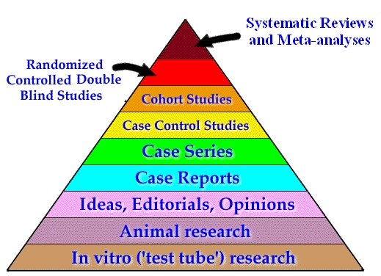
Hierarchy of studies
سلسله مراتب مطالعات

Slide 16
Evidence Pyramid
هرم شواهد
Type of Study
Systematic Review
Randomized Controlled Trial
Cohort studies
Case Control studies
Case Series/Case Reports
Animal research

Slide 17
Levels of Evidence
Level of Evidence | Type of Study
1a | Systematic reviews of randomized clinical trials (RCTs)
1b | Individual RCTs
2a | Systematic reviews of cohort studies
2b | Individual cohort studies and low-quality RCTs
3a | Systematic reviews of case-controlled studies
3b | Individual case-controlled studies
4 | Case series and poor-quality cohort and case-control studies
5 | Expert opinion based on clinical experience
Adapted from: Sackett DL et al. Evidence-Based Medicine: How to Practice and Teach EBM. 2nd ed. Churchill Livingstone; 2000.

Slide 18
انواع بانک‌های اطلاعاتی
در علوم پزشکی
دکتر پيام کبيری
پزشک، اپيدميولوژيست بالينی
رئيس مرکز توسعه و هماهنگی اطلاعات و انتشارات علمی
معاونت تحقيقات و فن‌آوری
وزارت بهداشت، درمان و آموزش پزشکی

Slide 19
انواع منابع اطلاعاتی در پزشکی بالينی
Primary resources
Secondary resources
Tertiary resources

Slide 20
Primary Resources
منابع اطلاعاتی اوليه
A primary source is firsthand original research or direct evidence concerning a topic under investigation not interpreted.
Primary resources are generally original articles that appear in peer-reviewed journals and are found primarily by searching Medline.
Require more work to validate.
Samples are Medline, Embase, ISI Web of Science, Scopus, …

Slide 21
Secondary Resources
منابع اطلاعاتی ثانويه
Secondary sources describe or analyze the primary sources, are summaries and analyses of the evidence derived from and based on primary sources.
A secondary source is a work that appraises, interprets or analyzes.
  Already reviewed, less work to validate.
Samples are Clinical Evidence, ACP Journal Club, and Cochrane Library, EBMR.

Slide 22
Tertiary Resources
منابع اطلاعاتی ثالثيه
Tertiary resources list, compile, digest or index primary or secondary sources.
Examples of tertiary resources include UpToDate, DynaMed, TripDatabase.

Slide 23
UpToDate Level of Evidence
There are two levels of recommendation strength (1 or 2)
  Strong
  Weak
There are three levels of quality of evidence (A,B,C)
  High
  Moderate
  Low

Slide 24
UpToDate Level of Evidence
1. Strong recommendation: Benefits clearly outweigh the risks and burdens (or vice versa) for most, if not all, patients
2. Weak recommendation: Benefits and risks closely balanced and/or uncertain

Slide 25
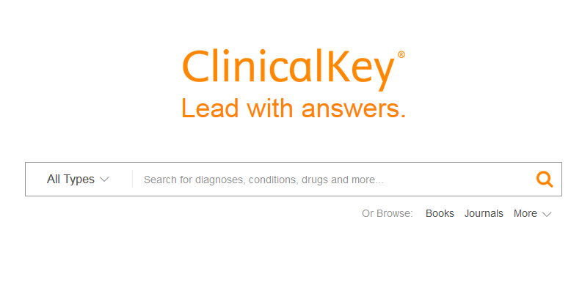
Clinical Key www.clinicalkey.com

Slide 26
دسترسي به مجموعه کتاب، مقاله، فيلم آموزشی، گايدلاين، مدلاين و .. Clinical Key
مجموعه Clinical Key از بخش Health ناشر Elsevier است که يک منبعClinical Decision Making محسوب می‌شود.
اين مجموعه شامل بخش‌های زير است:
  کتاب‌های مرجع بالينی و پايه
  مجلات
  مدلاين
  فيلم‌های آموزشی
  بانک اطلاعاتی دارويی
  دست‌نامه‌های آموزش بيماران

Slide 27
مجموعه کتاب، مقاله، فيلم آموزشی، گايدلاين، مدلاين و .. Clinical Key
+1,400 Topic Pages
  Quick clinical answers and summaries from Conn’s Current Therapy, Goldman’s Cecil Medicine, Ferri’s Clinical Advisor and First Consult
+1,200 Books
  Elsevier’s world-renowned medical and surgical books, including Gray’s Anatomy, Goldman’s Cecil Medicine, Braunwald’s Heart Disease, Campbell’s Operative Orthopaedics and more

Slide 28
مجموعه کتاب، مقاله، فيلم آموزشی، گايدلاين، مدلاين و .. Clinical Key
+600 Journals
  More than 600 top journals from Elsevier, including The Lancet and Journal of the American College of Cardiology
+17,000 Medical and Surgical Videos
  A continuously updated library of searchable video content

Slide 29
مجموعه کتاب، مقاله، فيلم آموزشی، گايدلاين، مدلاين و .. Clinical Key
+300 Procedures Consult Videos and Articles
  Step-by-step procedural videos and articles to teach techniques or simply help clinicians refresh their skills
+2,200,000 Images
  A continuously updated library of searchable images from trusted books and journal

Slide 30
مجموعه کتاب، مقاله، فيلم آموزشی، گايدلاين، مدلاين و .. Clinical Key
+850 First Consult Monographs
  Succinct, trusted clinical answers for clinicians at the point of care
+2,900 Drug Monographs
  Continuously updated, with detailed information about hundreds of specific prescription drugs, over-the counter products, nutritional supplements and herbals

Slide 31
مجموعه کتاب، مقاله، فيلم آموزشی، گايدلاين، مدلاين و .. Clinical Key
+15,000 Patient Education Handouts
  Educational handouts that can incorporate institutional branding and special instructions, as well as the patient's preferred language and text size
MEDLINE Abstracts
  Fully indexed, searchable abstracts retrieved daily from the National Library of Medicine

Slide 32
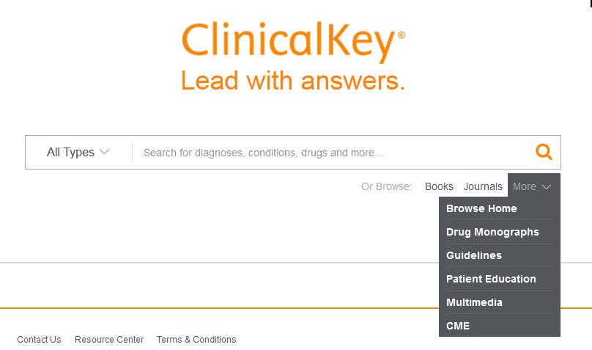
کتاب، مقاله، فيلم آموزشی، گايدلاين، مدلاين و .. http://www.clinicalkey.com/

Slide 33
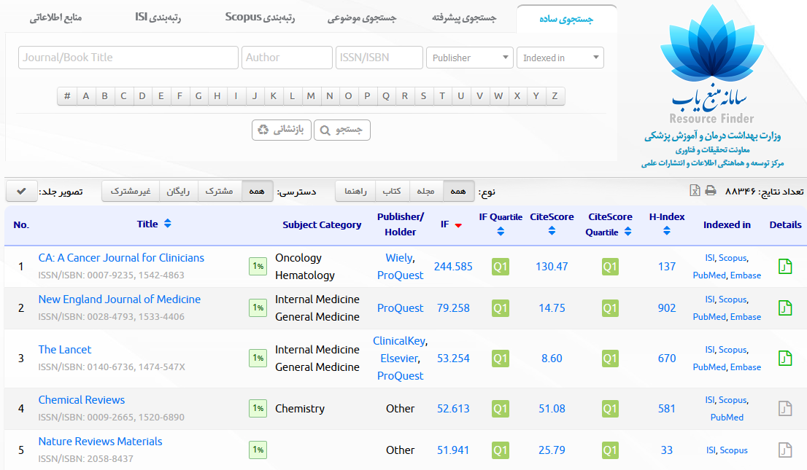
سامانه منبع‌ياب (Resource Finder) http://rsf.research.ac.ir/

Slide 34
بزنید ! Email اگر میل داشتید
kabiri@research.ac.ir
kabiri@behdasht.gov.ir

